Slide 1
Cover Letter Generator Using NLP and Deep Learning
Rachel Khoo
Thinkful Final Capstone
December 2020

Slide 2
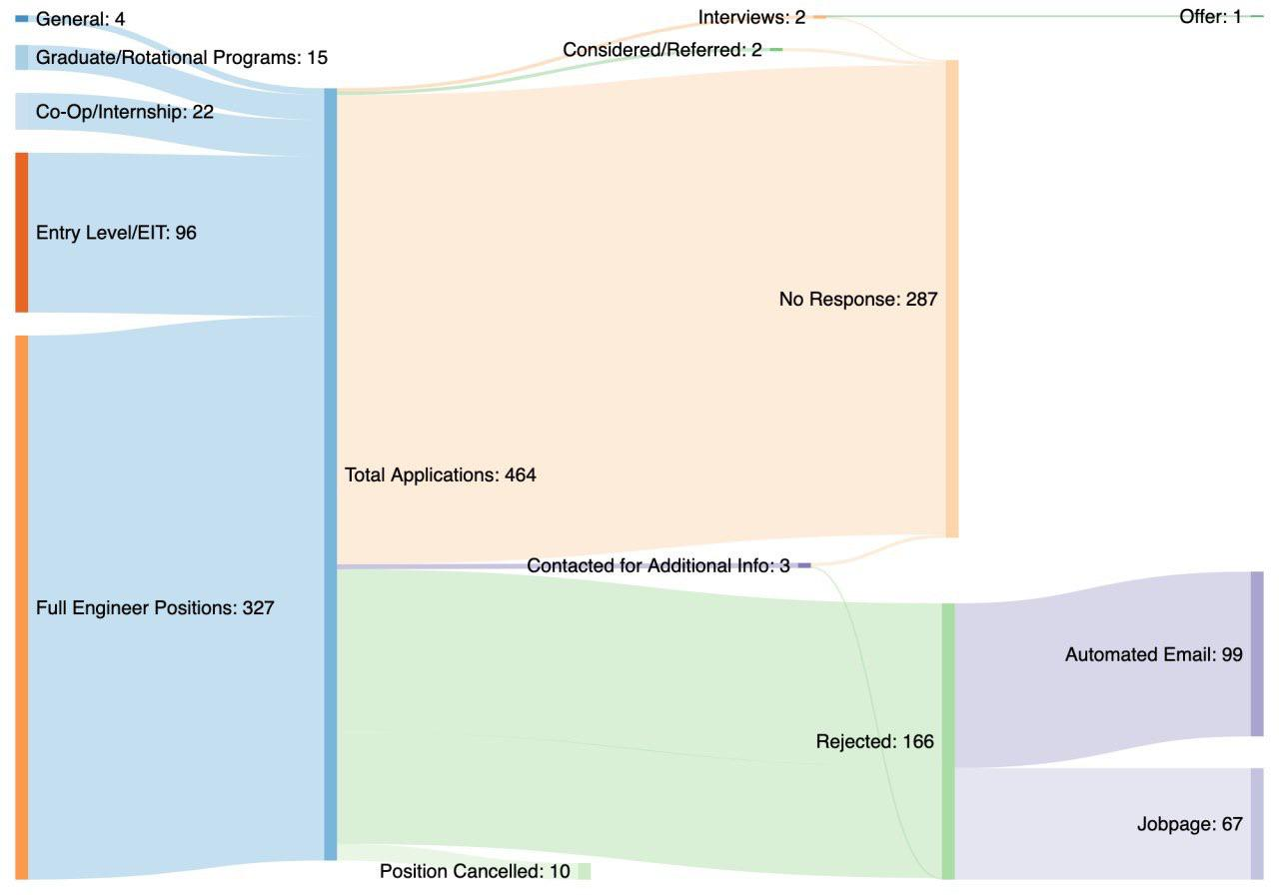
62% No response
Reddit user Majikthese
Notes:
464 Applications

Slide 3
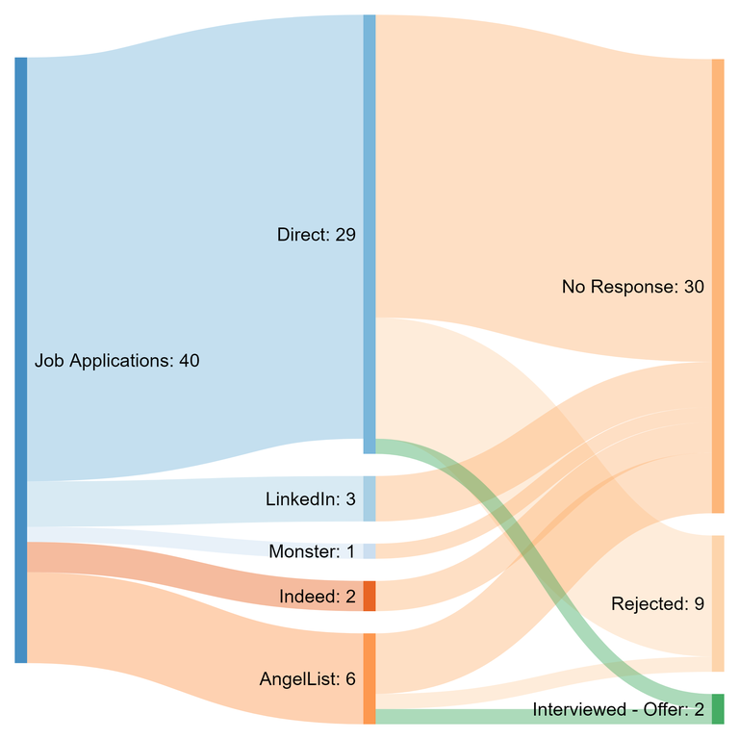
75% No response
Reddit user lightningboy_
Notes:
40 Applications

Slide 4
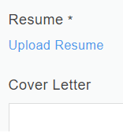
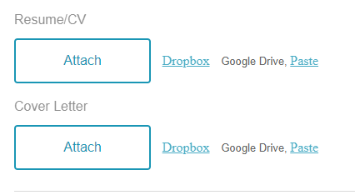
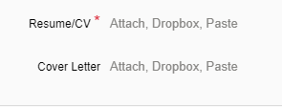
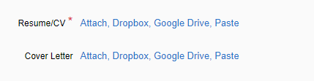


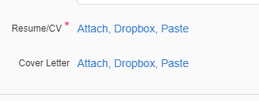
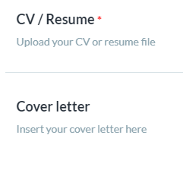
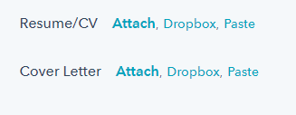
How do you set yourself apart?

Slide 5
NLP and Deep Learning
“I would like to apply for the Data Scientist position at Thinkful”
Generator
Unique Cover Letter

Slide 6
NLP and Deep Learning
Input: “I would like to apply for the [Data Scientist] position at [Thinkful]”
Sequence Length: 3
Step: 1
Output: “I would like”, “would like to”, “like to apply”, etc.
Notes:
Bidirectional Encoder Representations from Transformers

Slide 7
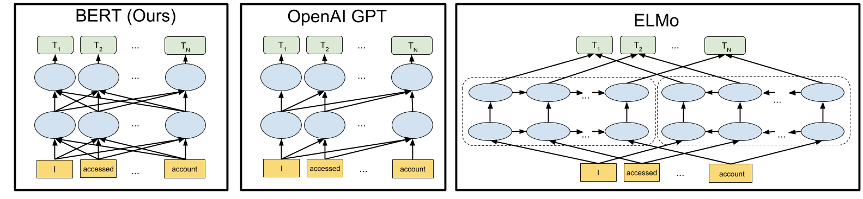
NLP and Deep Learning
BERT Encoder
Input: “I would like”,
“would like to”,
“like to apply”
Output: [2243, 1105, 1156],
[1105, 1156, 100],
[1156, 100, 1106]
would
Thinkful
https://towardsdatascience.com/bert-in-keras-with-tensorflow-hub-76bcbc9417b
Notes:
Bidirectional Encoder Representations from Transformers

Slide 8
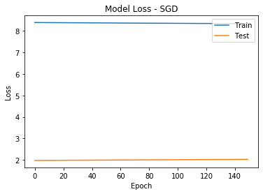
SGD Optimizer
Input: “I would like to apply”
Notes:
Sigmoid gradient descent

Slide 9
SGD Optimizer
Output: “I would like to apply and and and and and
and and and and and and and and and and
and and and and and and and and and and”

Slide 10
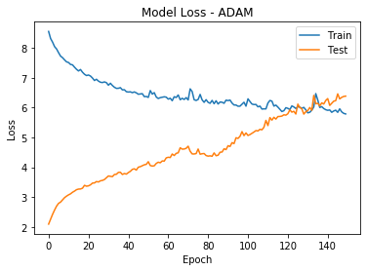
Adam Optimizer
Input: “I would like to apply”
Notes:
Adaptive moment estimation
Losses begin to converge, with more epochs they diverge again
Bring the loss to about 6

Slide 11
Adam Optimizer
Output: “I would like to apply on-strategy [yourcompany] consideration
a [yourcompany] problem-solving confident the me passionate
cost me passionate cost me passionate cost me passionate
cost me passionate cost me passionate”

Slide 12

There is more work to be done
More training data
Tuning hyperparameters
Using resume as input
“data science”, “collaborative”, “communication”, “teamwork”

